Slide 1
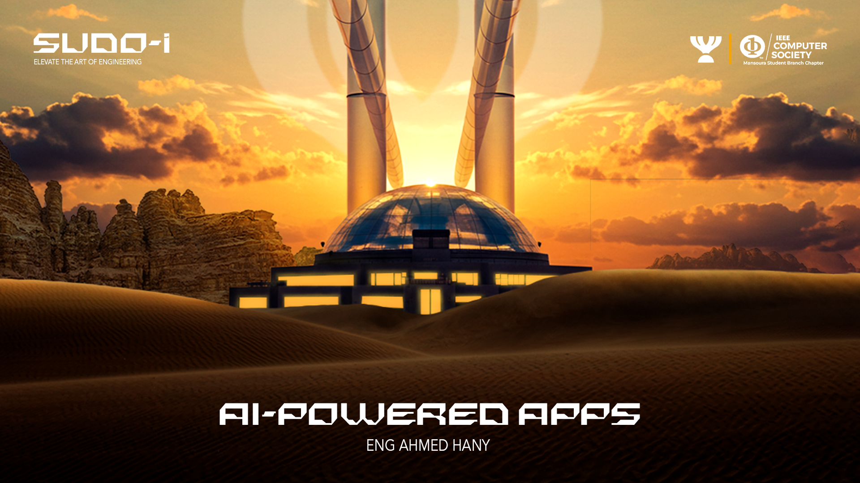

Slide 2
Table of content
1
Intro to AI and ML
4
Some coding :)
2
Large Language Models (LLMs)
5
Building a simple application
3
Get API key
6
Finding ML models

Slide 3

1
Intro to AI and ML

Slide 4
Turing Test
Symbolic AI
AI WINTER
MACHINE LEARNING
AI Winter
Machine Learning

Slide 5
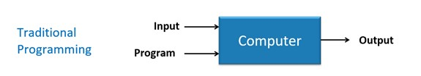
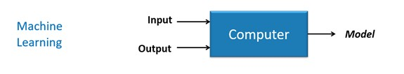
Difference Between Machine Learning and Traditional Programming

Slide 6

Suppose you own 10m² of land and you wanted to know the price of your land.
- Well, You asked some of your friends that also own a land.

Slide 7




I have 5m² of land and the price is 5000$
I have 7m² of land and the price is 7000$
I have 4m² of land and the price is 4000$
- Then My 10m² of land worth 10000$.
Price = 1000 * Area

Slide 8
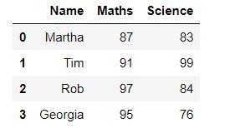
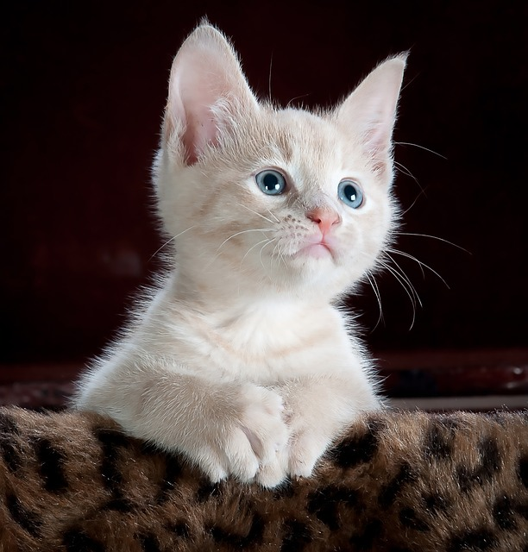
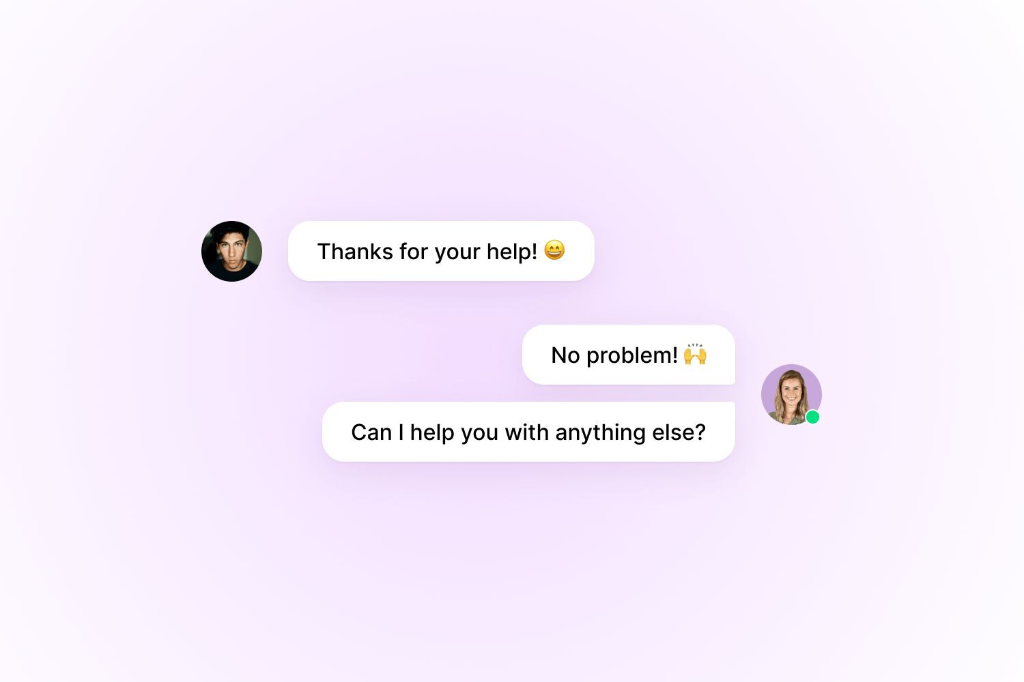
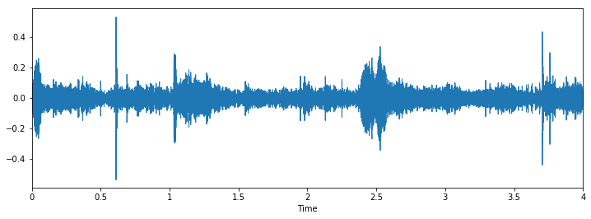

Data can be :
Tabular
Text
Audio
Tabular
Images
Text
Audio

Slide 9
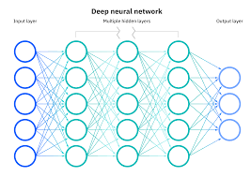
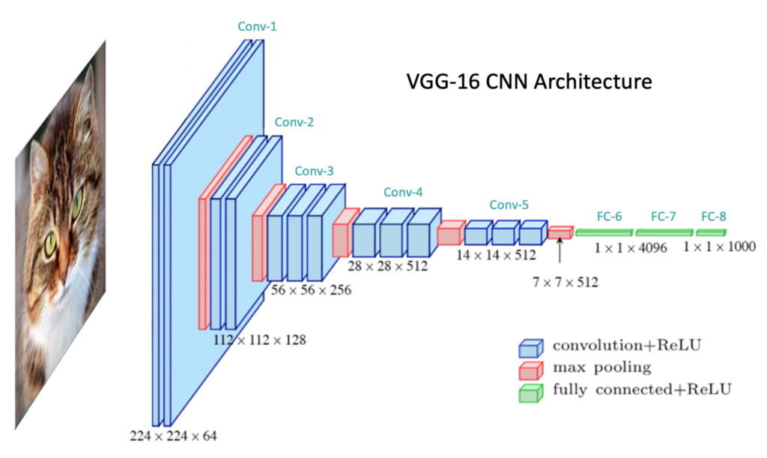
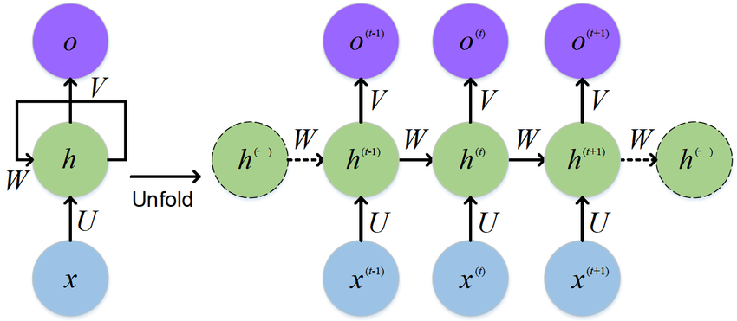
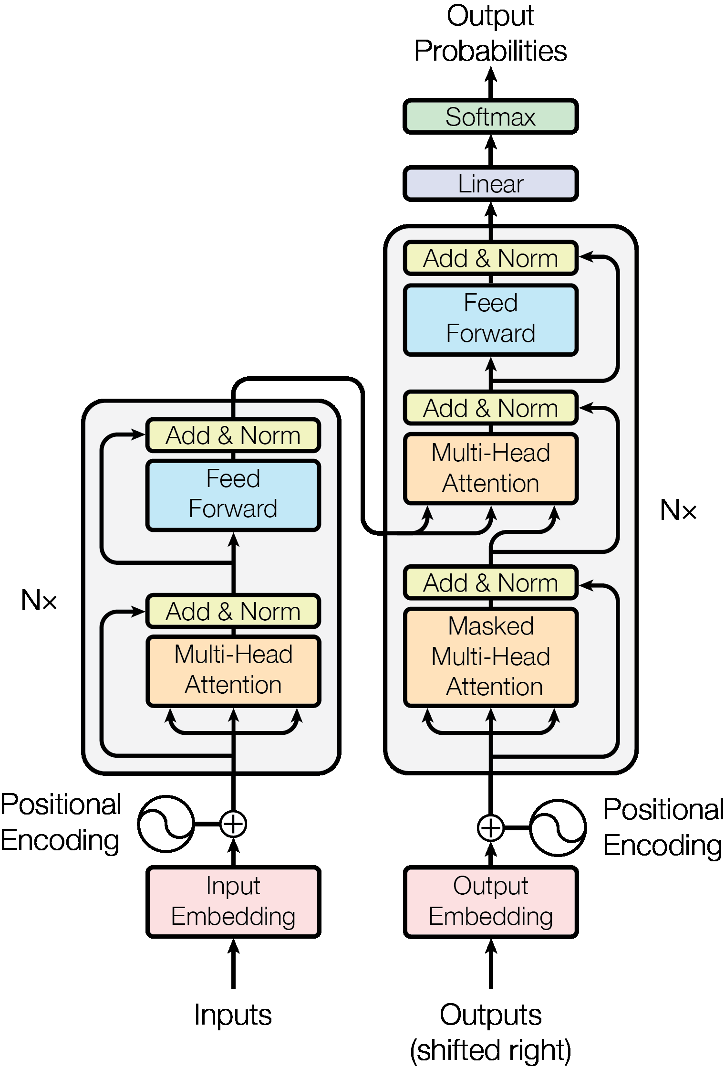
Neural Networks

Slide 10
2
Large Language Models

Slide 11
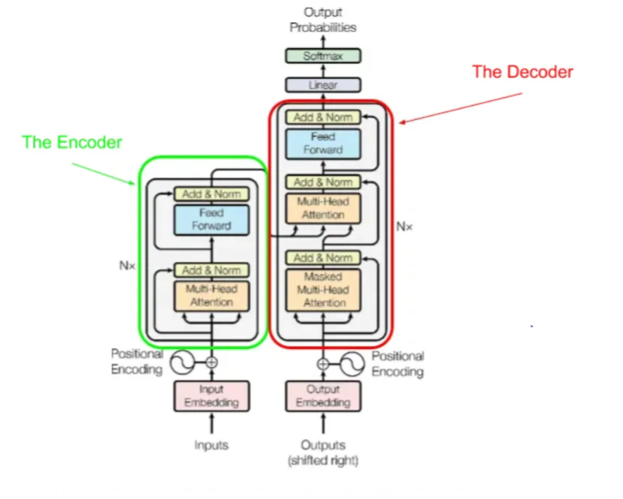

Slide 12
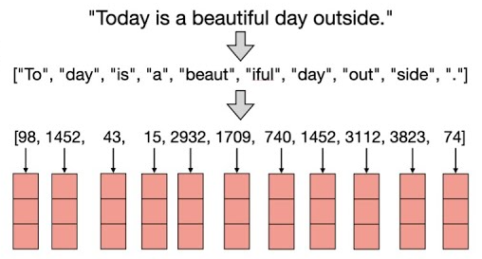

Slide 13
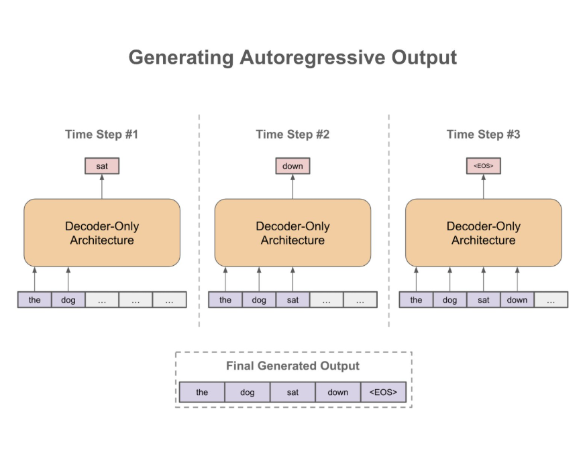
let’s try gpt decoder :)
gpt

Slide 14
3
Get an API key

Slide 15
Getting Free gemini API key for using the LLM directly from : gemini-api-key

Slide 16
4
coding time :)

Slide 17
5
Make the LLM solve these puzzles for us :)

Slide 18
use this link for the API key : https://aistudio.google.com/app/apikey
also you can use google colab to run the code without downloading the requirements internally
A farmer needs to cross a river with a wolf, a goat, and a cabbage. His boat can only carry one item besides himself. If left alone, the wolf will eat the goat, and the goat will eat the cabbage. How does he get all three across safely?
A bat and a ball cost 1.10 in total. The bat costs 1.00 more than the ball. How much does the ball cost?
A man counts 10 seconds between entering a tunnel and exiting it in a train moving at 60 km/h. How long is the tunnel?

Slide 19
6
other open source machine learning models :)

Slide 20


hugging face
Roboflow

Slide 21
References :
Machine Learning Specialization
Langchain for LLM applications
Google gemini doc.
Langchain Repo.
huggingface models.

Slide 22


THANK YOU
FOR LISTENING
ANY QUESTIONS ?

